Slide 1
HTML Exasflajkjalkjfercise #1
“My First Website”

Slide 2
Activity #1: Make a Simple Website with three pages
About Me
Academic Life
Contact Me

Slide 3
About Me
Must have the ff.
A list with links to the other two pages
“Me In a Nutshell”: Find an image that describes you right now
“My Interests”: Create a list of your interests
UI Design is up to you

Slide 4
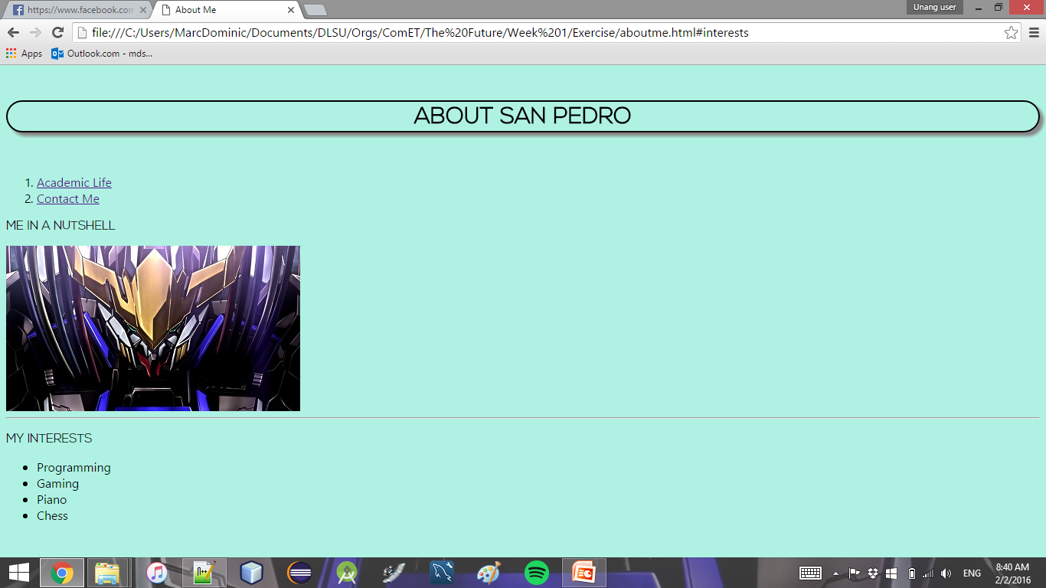
Sample About Me Page

Slide 5
Academic Life
Must have the ff.
ID Number
Course
A table of your current subjects this term (minimum info required is Course and Section, but feel free to add more columns if you so desire)
A link back to About Me

Slide 6
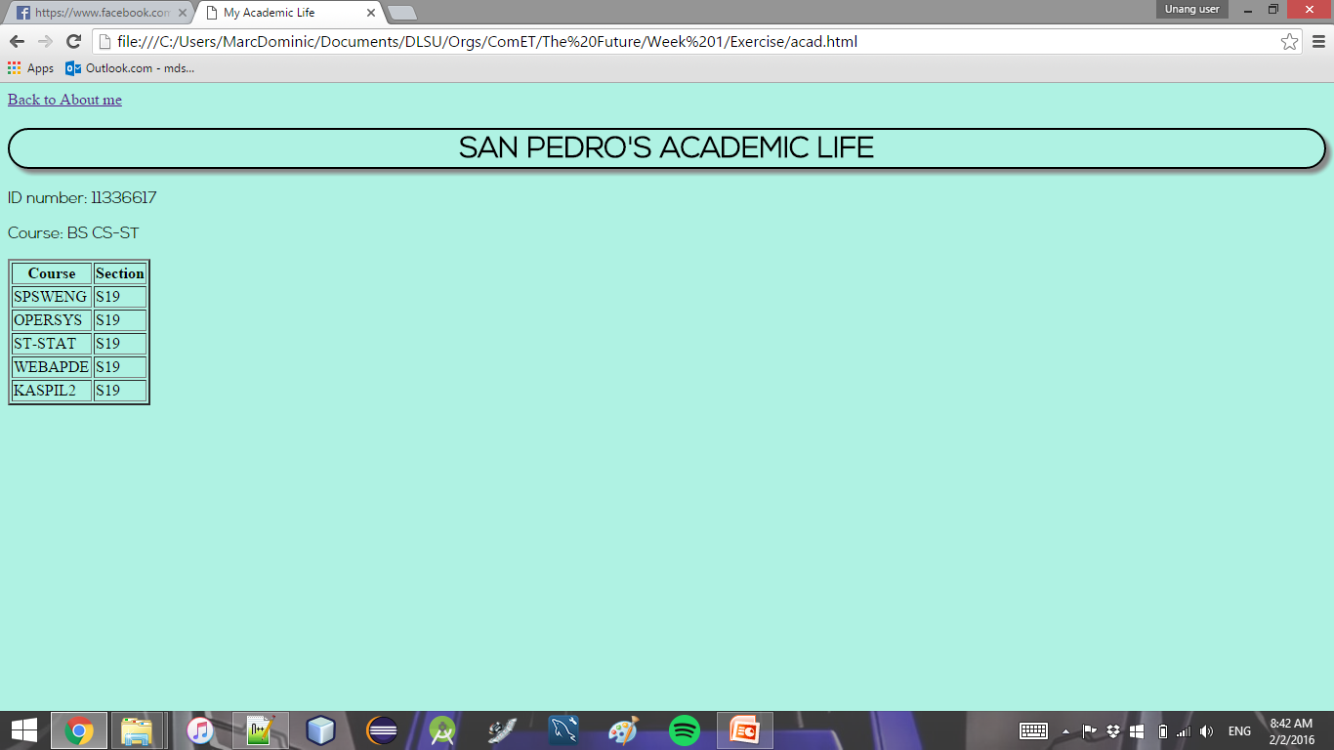
Sample Academic Life Page

Slide 7
Contact Me
Must have the ff.
Text field for email address
Dropdown box for area of concern (minimum 3 items, actual values are up to you)
Text field for title / subject
Text area for content
Submit button
A link back to About Me

Slide 8
Contact Me
Note: no need for functionality yet (ie. Nothing needs to happen when the submit button is pressed)

Slide 9
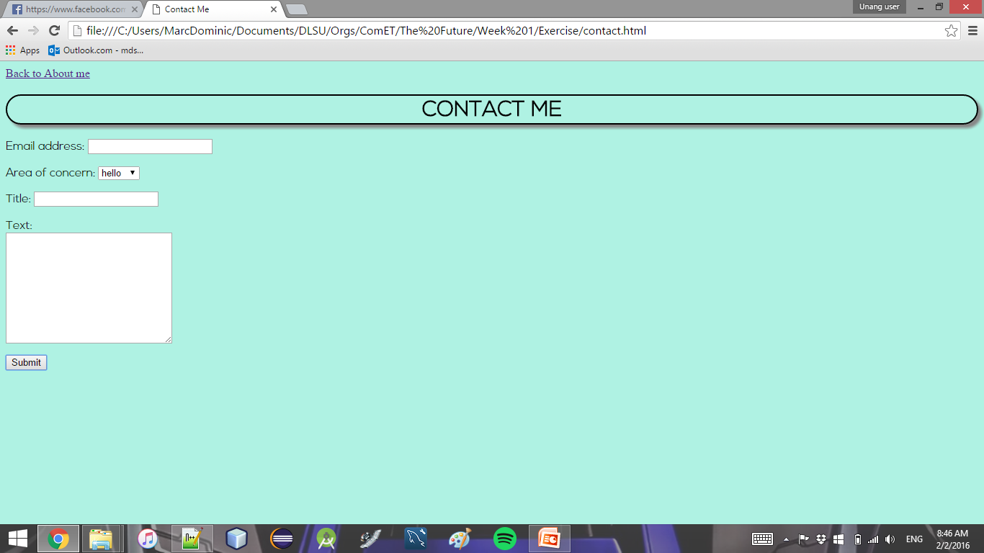
Sample Contact Me Page

Slide 10
Submission Details
Make sure you have a good internet connection
Navigate to your repository in cmd
Type “git add -A”
Type “git commit -m <your message>”
Type “git push”
Enter your username and password
Done!

